Slide 1
Parking on Block 1129: Challenges and opportunities
Prospect Heights Neighborhood Development Council
March 8, 2012

Slide 2
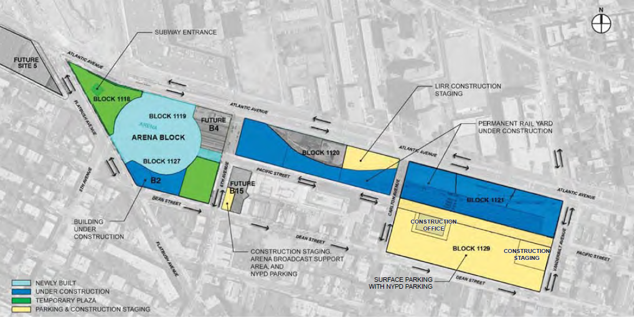
1129 is last planned for development in Phase II
Technical Analysis of an Extended Build-Out of the Atlantic Yards Arena and Redevelopment Project, ESDC, 12/10

Slide 3
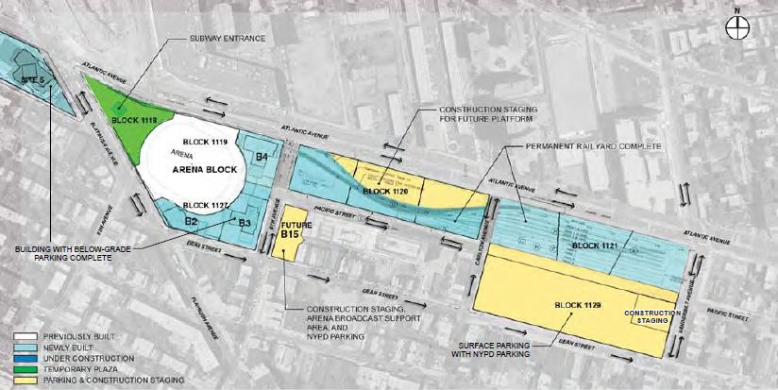
1129 is last planned for development in Phase II
Technical Analysis of an Extended Build-Out of the Atlantic Yards Arena and Redevelopment Project, ESDC, 12/10

Slide 4
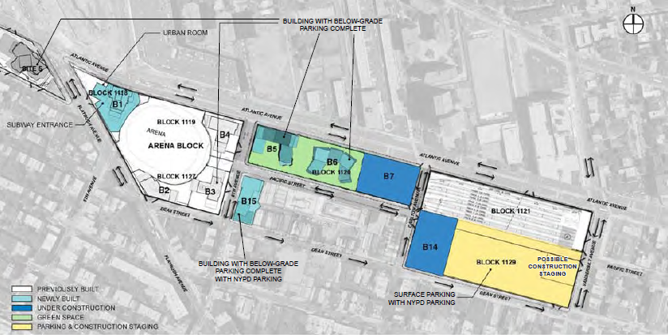
1129 is last planned for development in Phase II
Technical Analysis of an Extended Build-Out of the Atlantic Yards Arena and Redevelopment Project, ESDC, 12/10

Slide 5
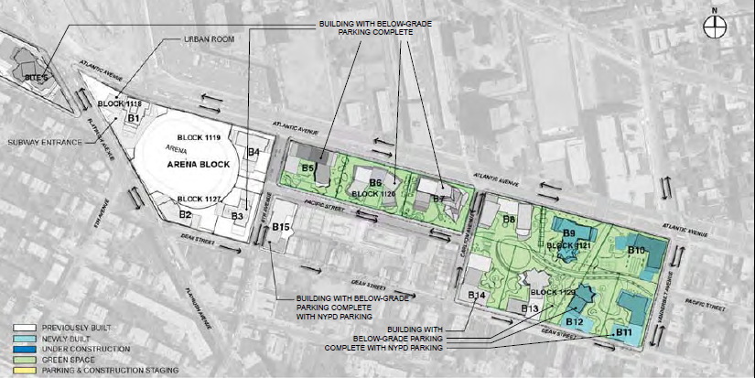
1129 is last planned for development in Phase II
Technical Analysis of an Extended Build-Out of the Atlantic Yards Arena and Redevelopment Project, ESDC, 12/10

Slide 6
Plans call for an initial 1,100 cars on 1129
From ESDC’s December 2010 technical analysis

Slide 7
Nothing may be built on 1129 for 10 years…
From the Atlantic Yards Development Agreement

Slide 8
…and parking use may continue for 25 years
From the Atlantic Yards Development Agreement

Slide 9
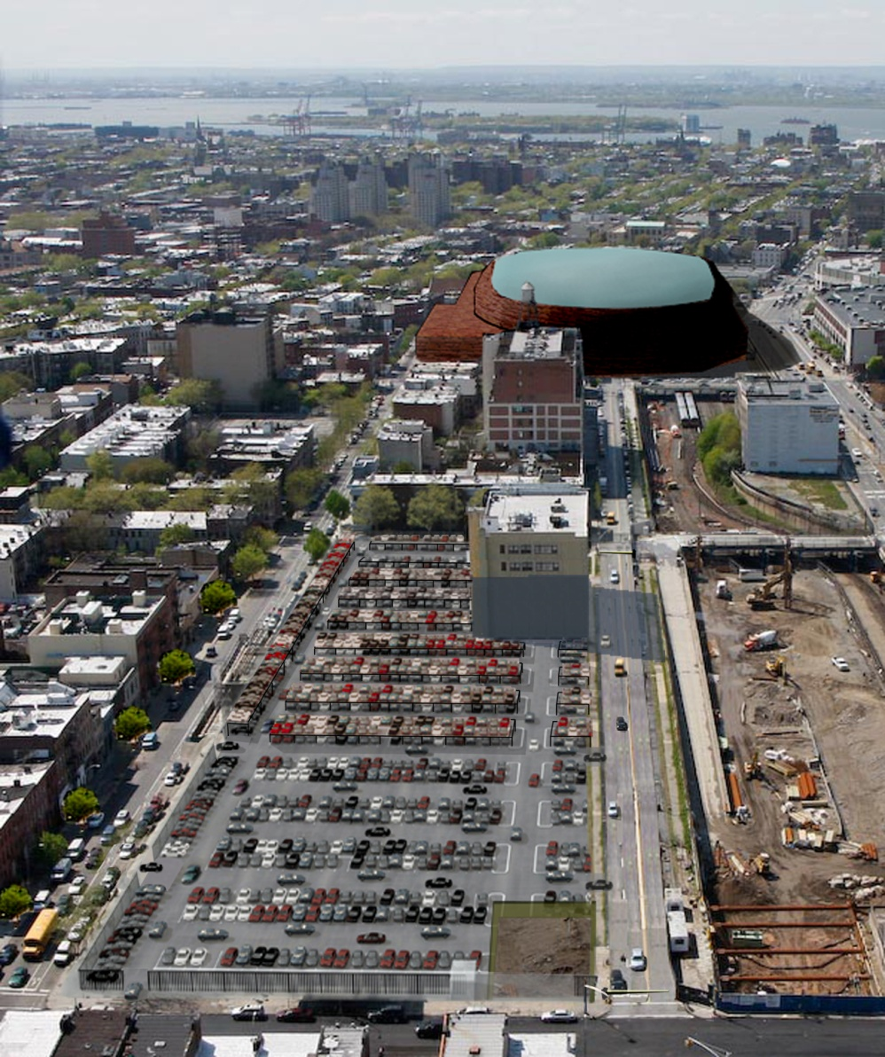
1,100 cars on a single block is a blight…
Queuing during entering and leaving causes traffic congestion
Giant paved area leads to storm water runoff, “heat island” effect
Air quality impact from unfiltered exhaust
Noise and activity disruptive to nearby residents

Slide 10
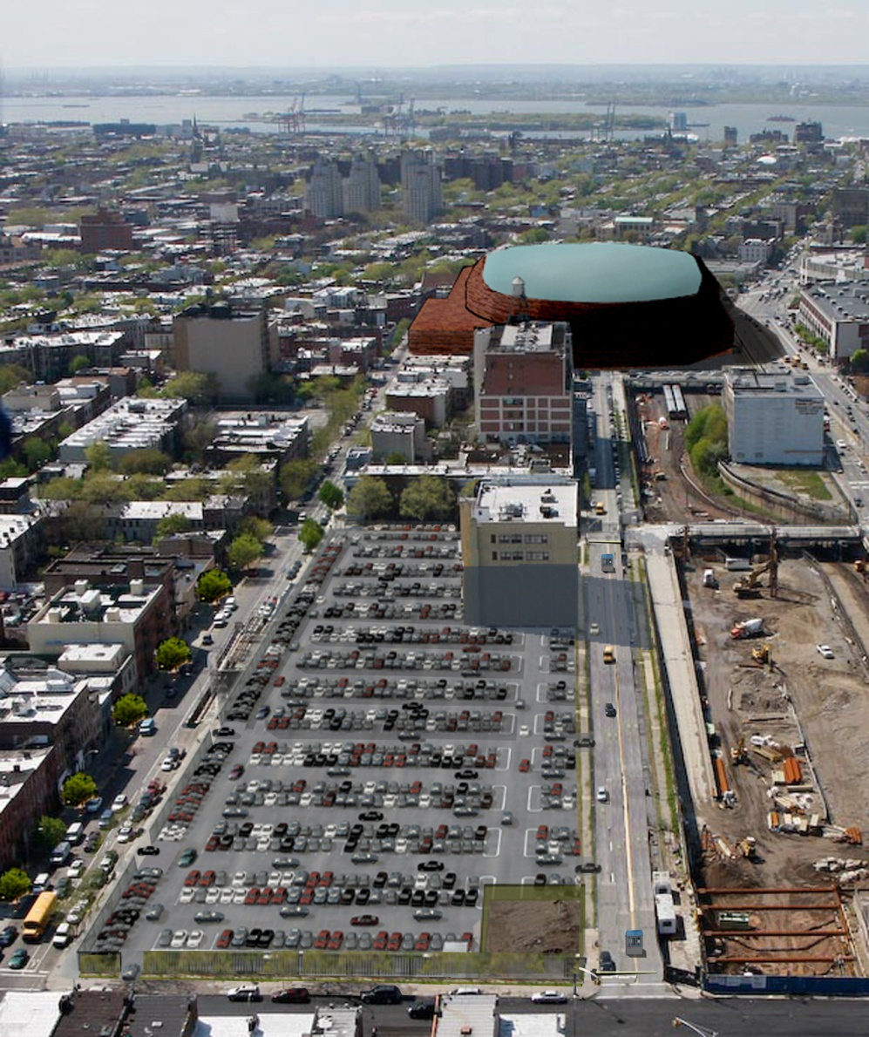
…and 800-900 isn’t much better
Queuing during entering and leaving causes traffic congestion
Giant paved area leads to storm water runoff, “heat island” effect
Air quality impact from unfiltered exhaust
Noise and activity disruptive to nearby residents

Slide 11
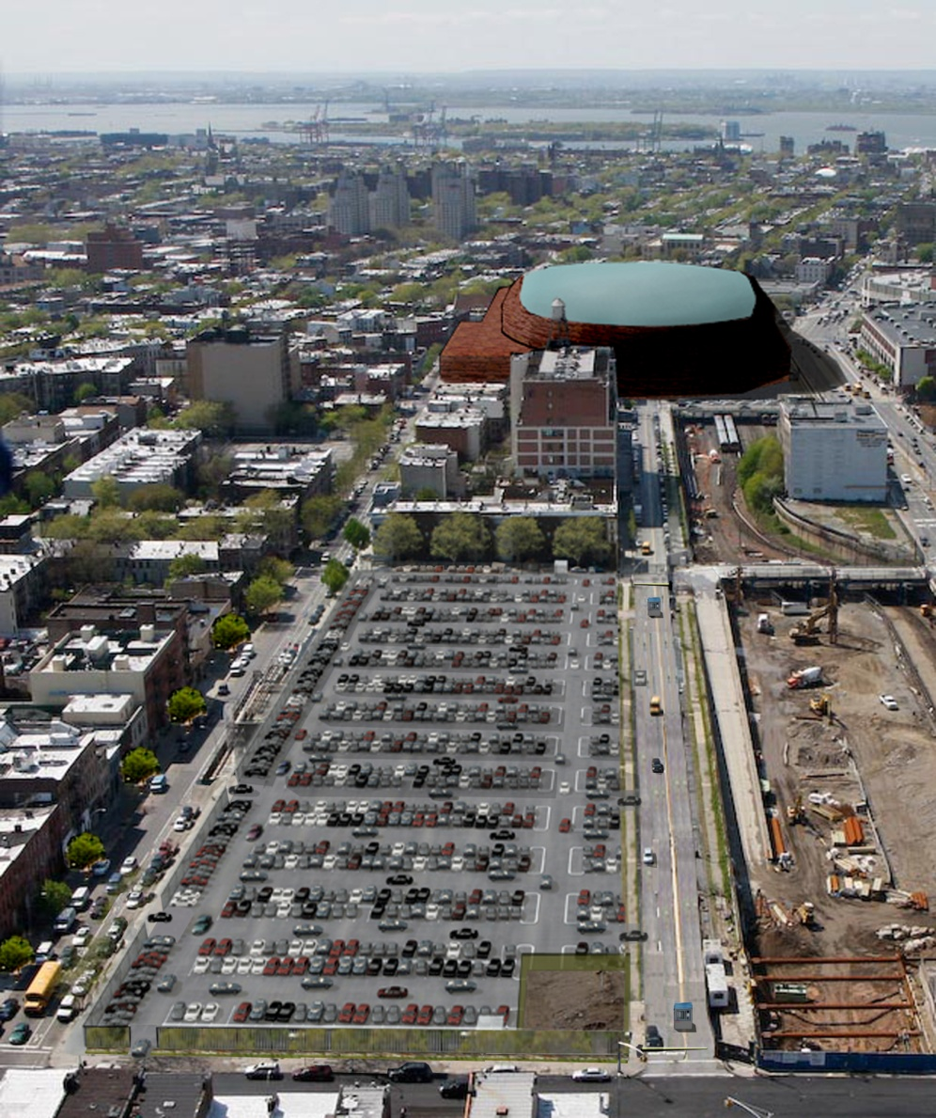
…and 800-900 isn’t much better
Queuing during entering and leaving causes traffic congestion
Giant paved area leads to storm water runoff, “heat island” effect
Air quality impact from unfiltered exhaust
Noise and activity disruptive to nearby residents

Slide 12
That’s why NYC regulates surface lot design
Standards adopted in 2007:
Mitigate vast expanses of pavement through landscaping
Improve quality of local streetscape
Increase tree canopy to reduce “heat island effect”
Increase permeability to reduce storm water runoff
Improve pedestrian and vehicular circulation and safety

Slide 13
Street trees and perimeter screening
Design Standards for Commercial and Community Facility Parking Lots, NYC DCP, 6/07

Slide 14
Street trees and perimeter screening
Design Standards for Commercial and Community Facility Parking Lots, NYC DCP, 6/07

Slide 15
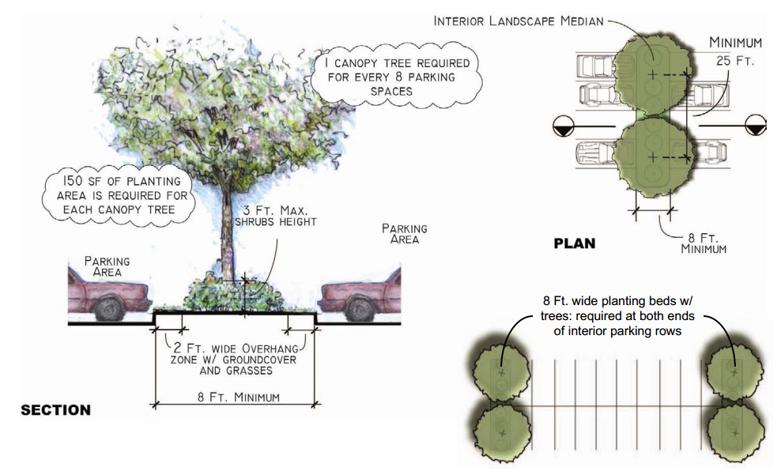
Interior landscaping
Design Standards for Commercial and Community Facility Parking Lots, NYC DCP, 6/07

Slide 16
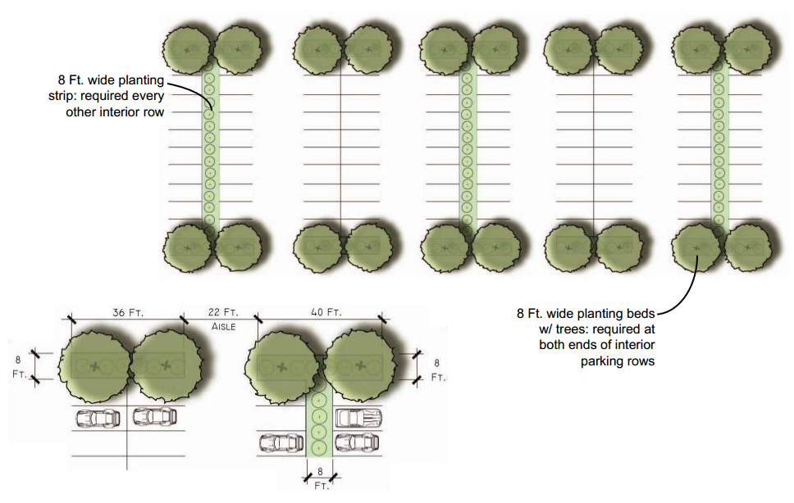
Interior landscaping
Design Standards for Commercial and Community Facility Parking Lots, NYC DCP, 6/07

Slide 17
Example: before City standards

Slide 18
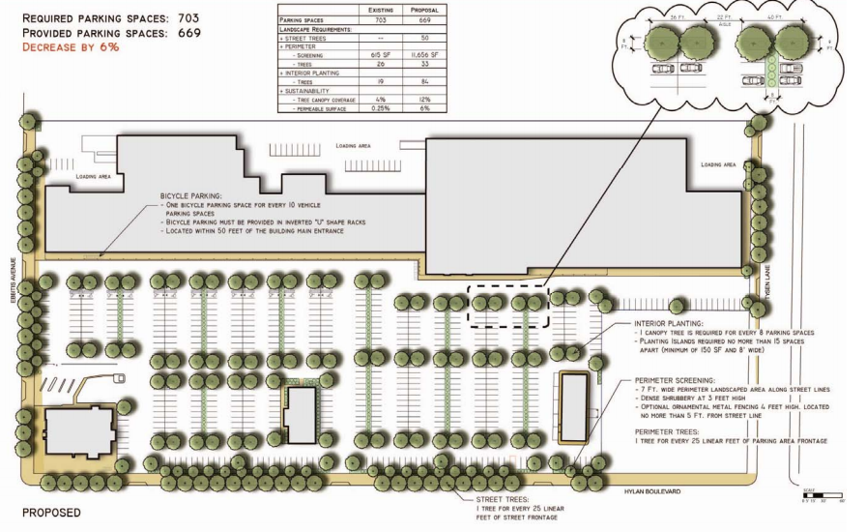
Example: after City standards

Slide 19
Better design helps mitigate parking impact
Reduce capacity to 500 spaces
Use permeable pavement
Locate entrances on Pacific Street to avoid traffic using and blocking residential streets
Include kiosk to better integrate with neighborhood

Slide 20
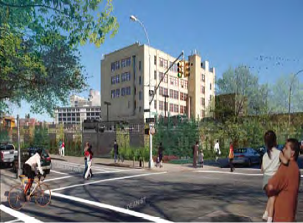
Parking should not be an end state
Block 1129 was to be the site of affordable housing, “publicly accessible” open space, and a public school; these benefits continue to be important to the community and need to be delivered
Other options may exist for programming parking that support earlier delivery of promised public benefits as well as address local concerns about impacts from the surface lot
Image: Technical Analysis of an Extended Build-Out of the Atlantic Yards Arena and Redevelopment Project, ESDC, 12/10

